Slide 1
REDS项目内外饰重点零部件外表面处理工艺
R涉密

Slide 2
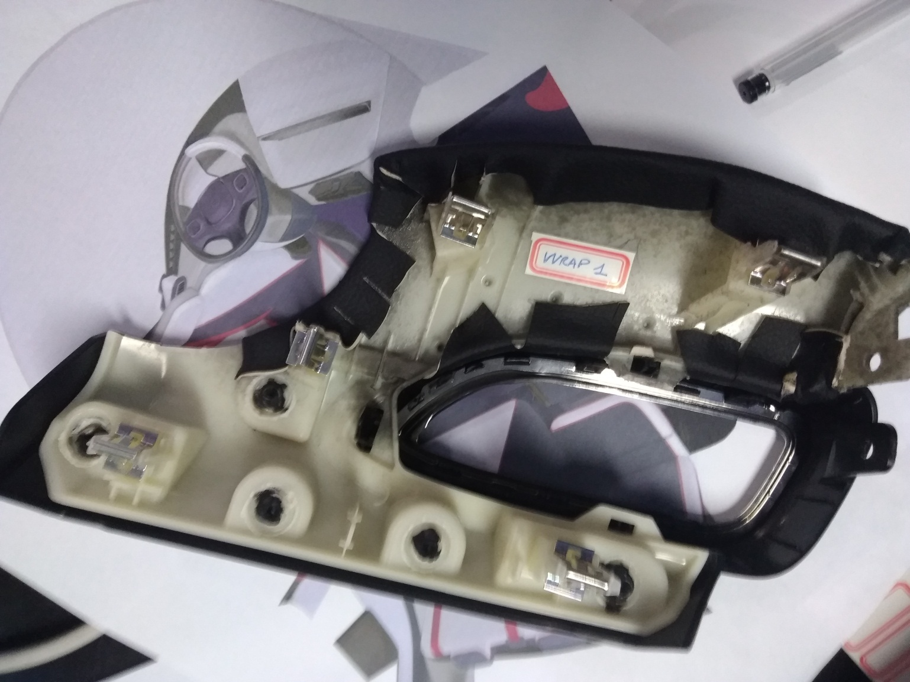
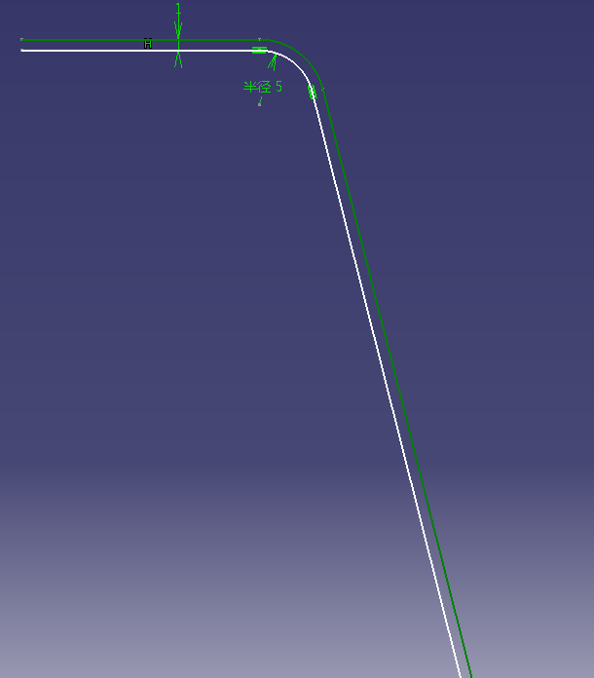
表面处理及工艺建议——REDS
Surface treatment and process suggestions - REDS
1mm PVC表皮
骨架

Slide 3
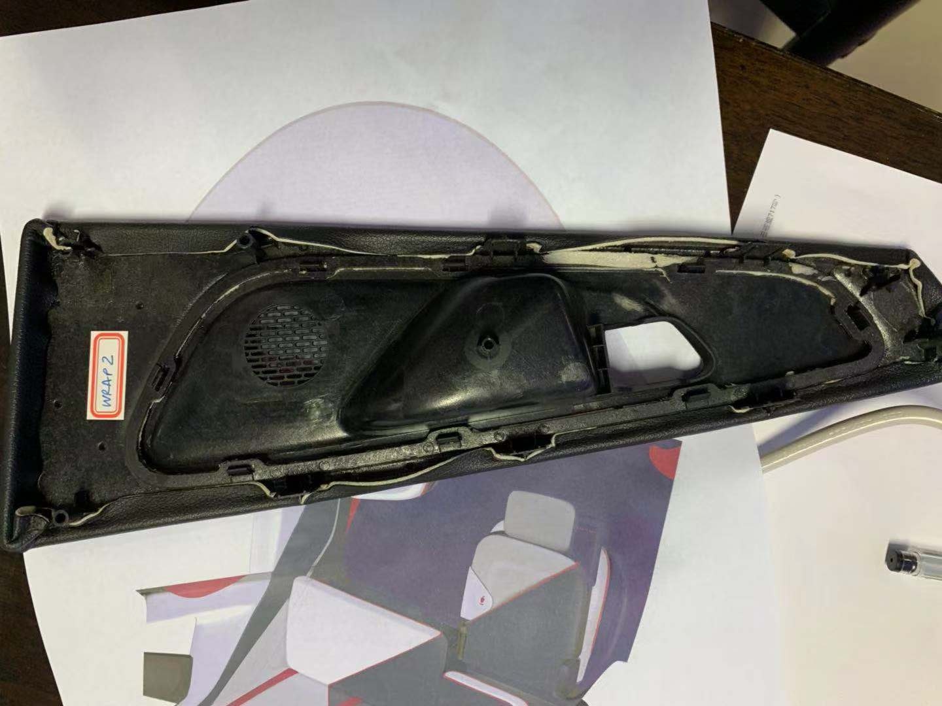
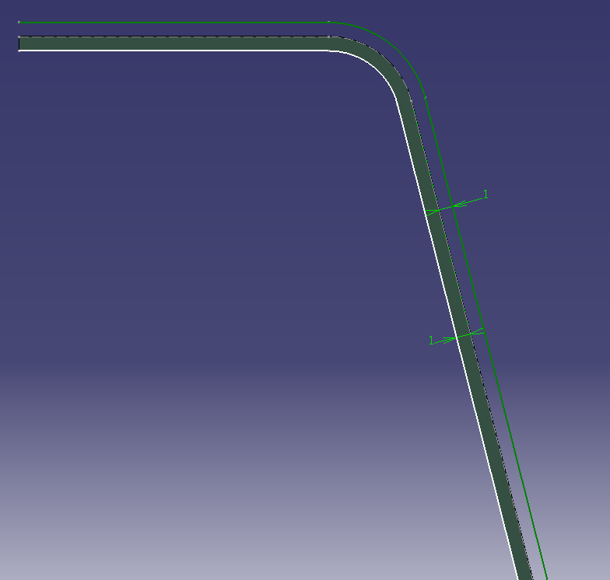
表面处理及工艺建议——REDS
Surface treatment and process suggestions - REDS
1mm PVC表皮
骨架
1mm PU发泡

Slide 4
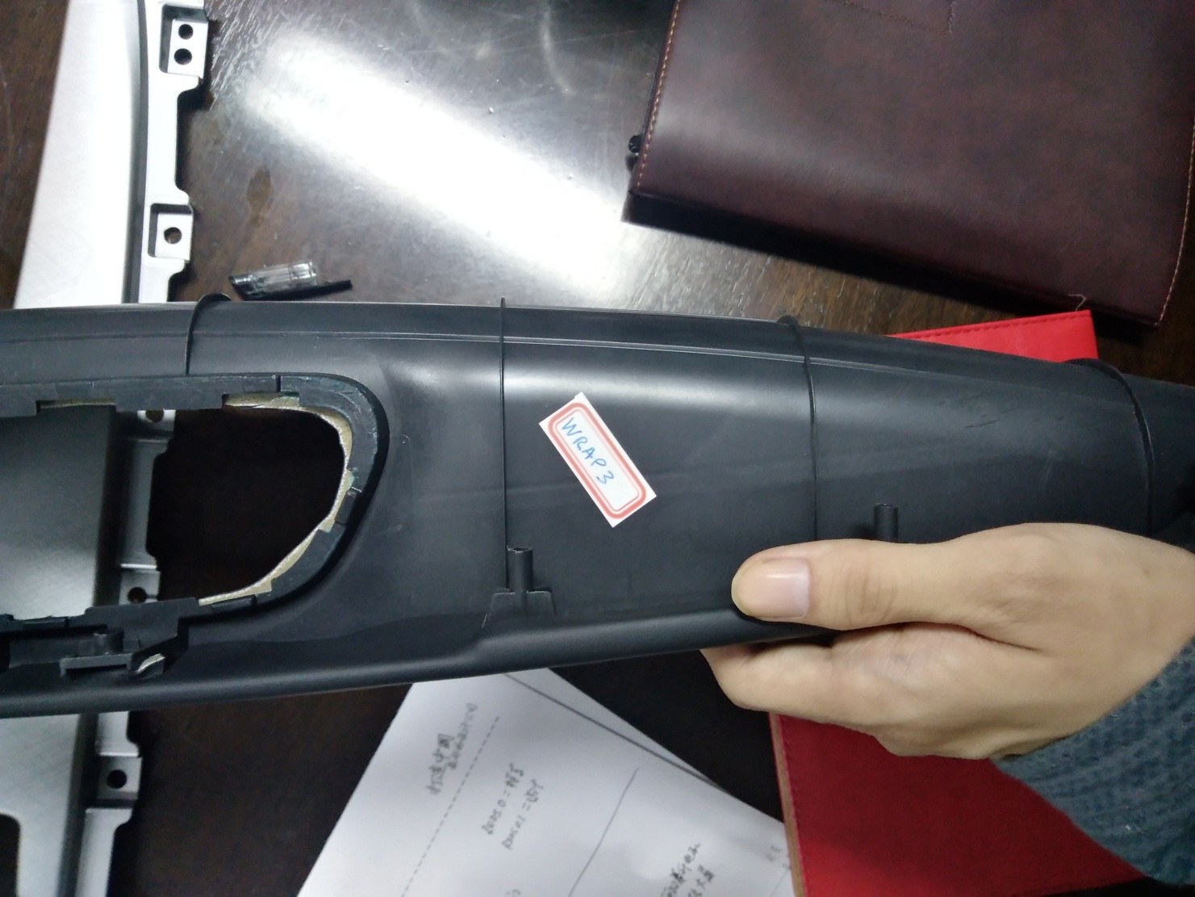
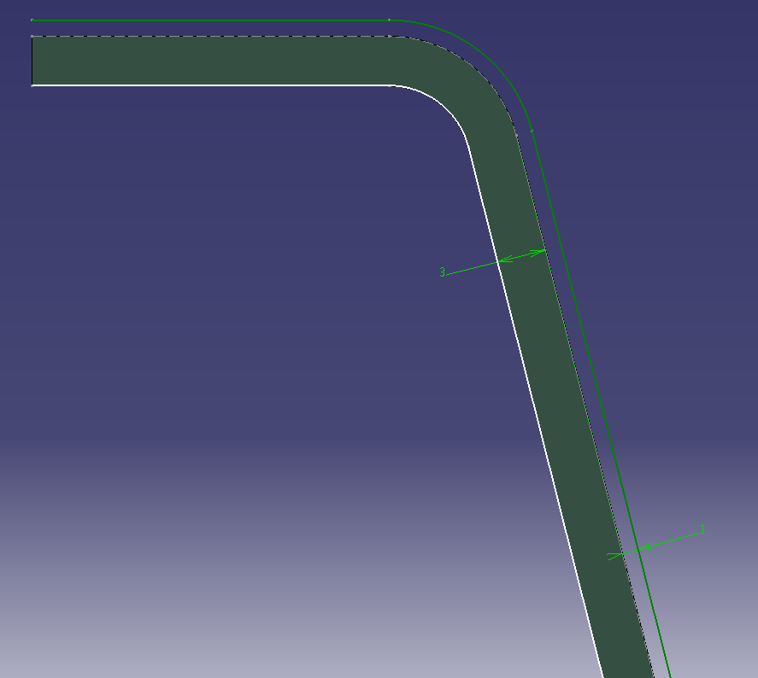
表面处理及工艺建议——REDS
Surface treatment and process suggestions - REDS
1mm PVC表皮
骨架
3mm PU发泡

Slide 5
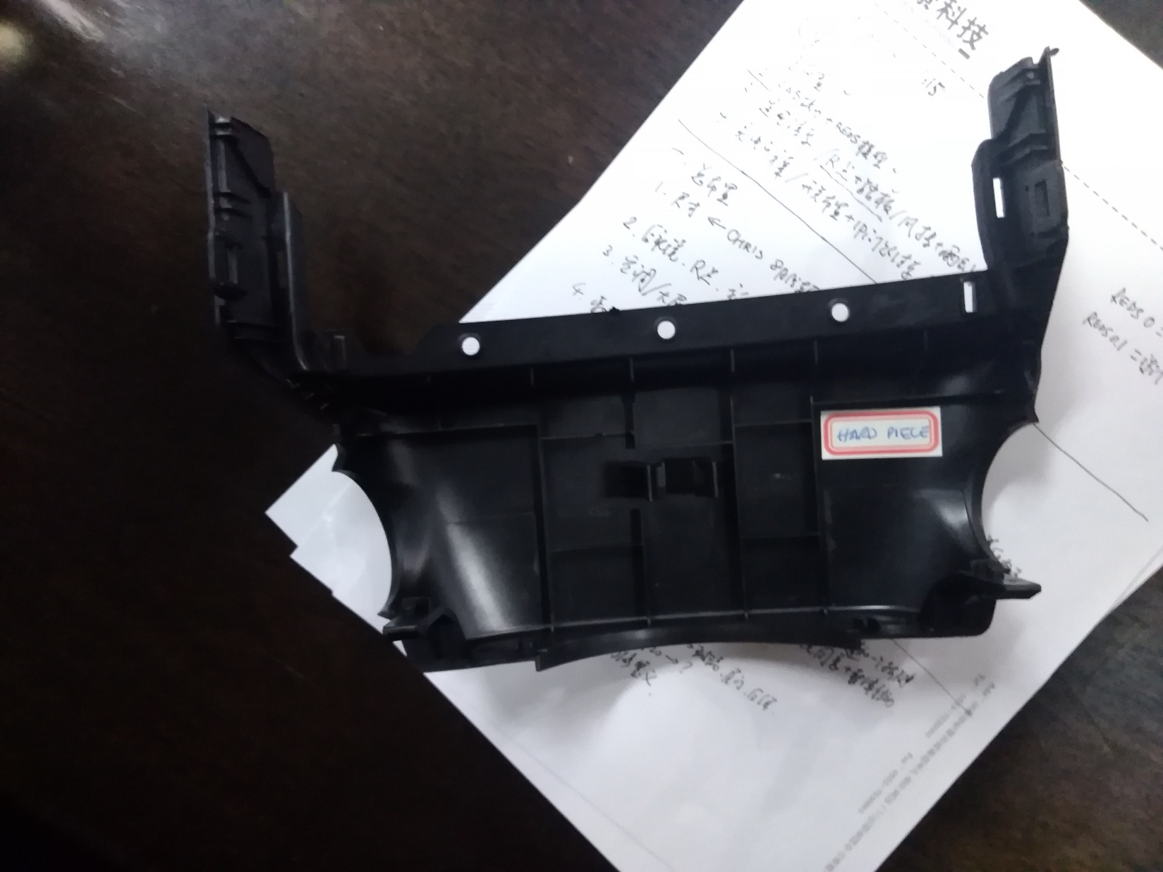
表面处理及工艺建议——REDS
Surface treatment and process suggestions - REDS
工艺：硬质注塑

Slide 6
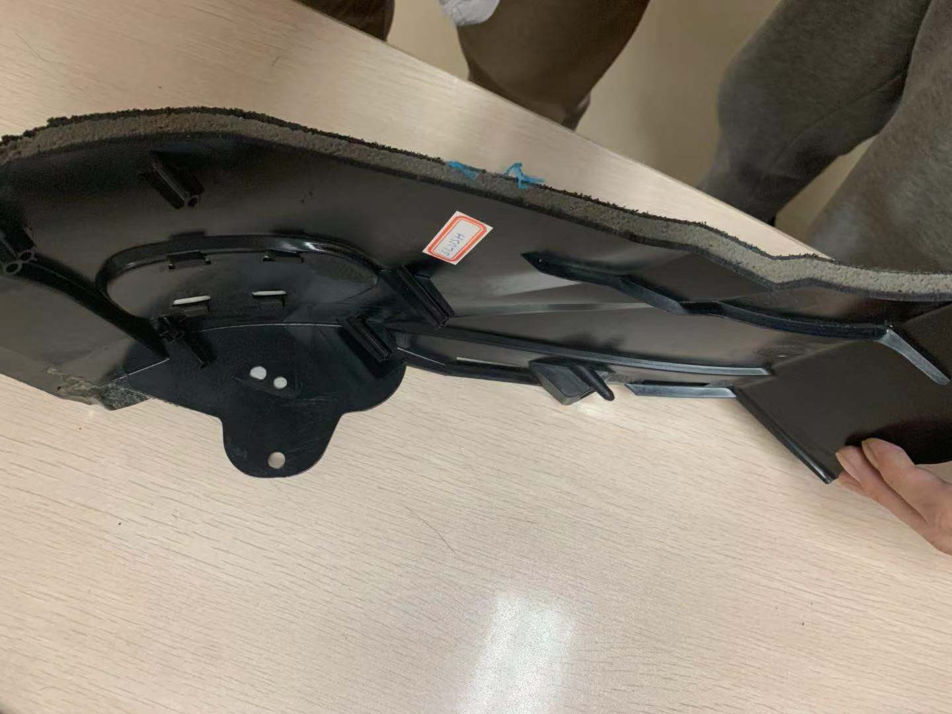
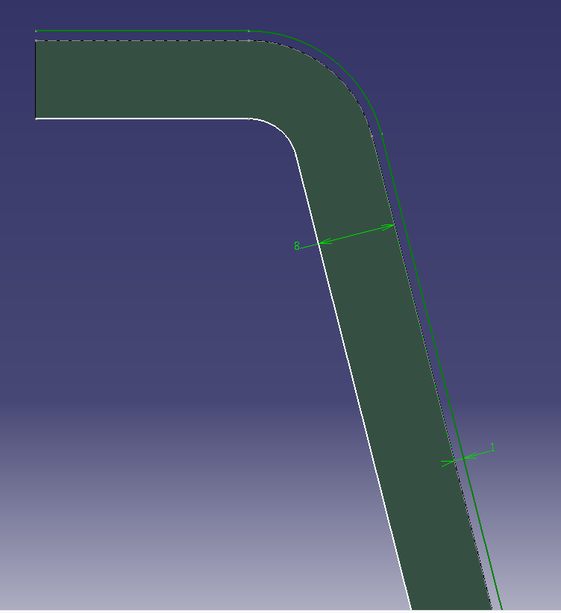
表面处理及工艺建议——REDS
Surface treatment and process suggestions - REDS
1mm PVC表皮
骨架
8mm PU发泡

Slide 7
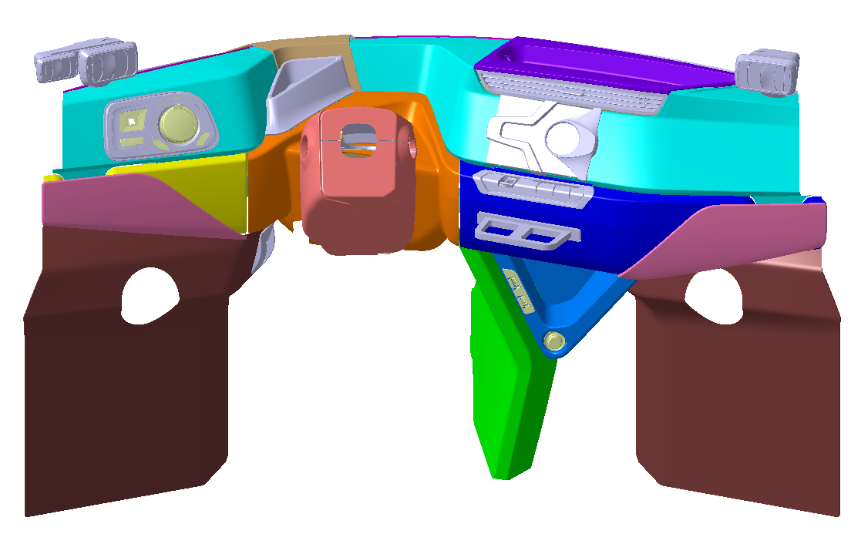
表面处理及工艺建议——REDS仪表板
Surface treatment and process suggestions – REDS IP
SLUSH
SLUSH
HARD
SOFT PAINT
WRAP 1
WRAP 1
HARD
SOFT PAINT
WRAP 1
HARD PLASTIC
HARD PLASTIC
WRAP 3
WRAP 3
HARD
SOFT PAINT
HARD PLASTIC
WRAP 3

Slide 8
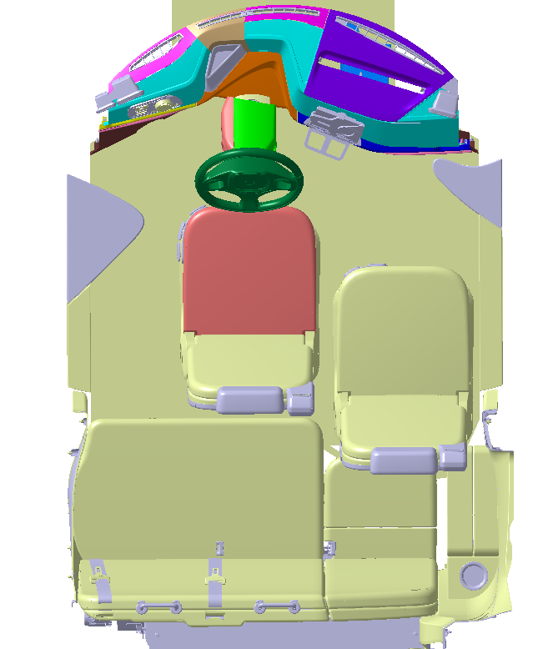
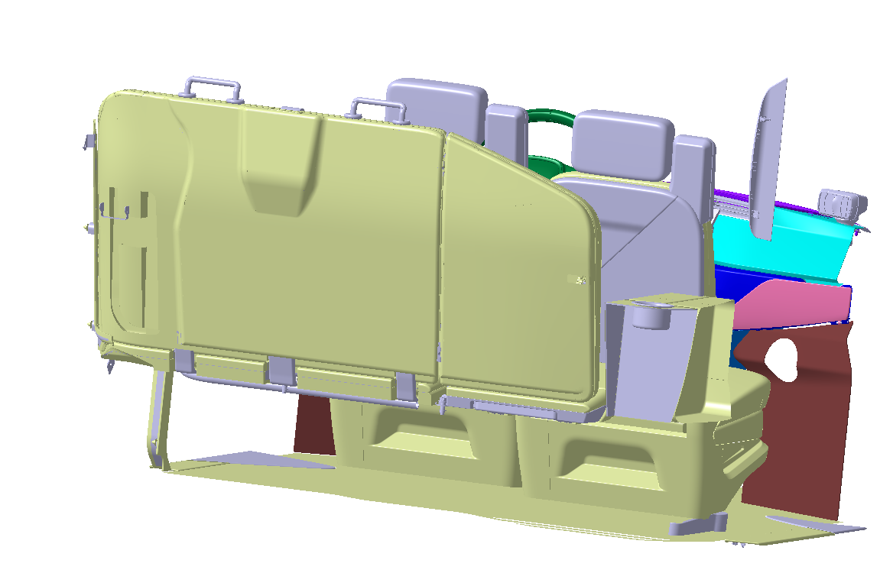
表面处理及工艺建议——REDS
Surface treatment and process suggestions - REDS
WRAP 1
HARD PLASTIC
WRAP 1
HARD SOFT PAINT
HARD PLASTIC
HARD
SOFT PAINT
Or
BACK-INJECTOR RUBBOR INCOLOR
CARPET
WRAP
TEXTILE OR LEATHER
HARD PLASTIC
HARD PLASTIC

Slide 9
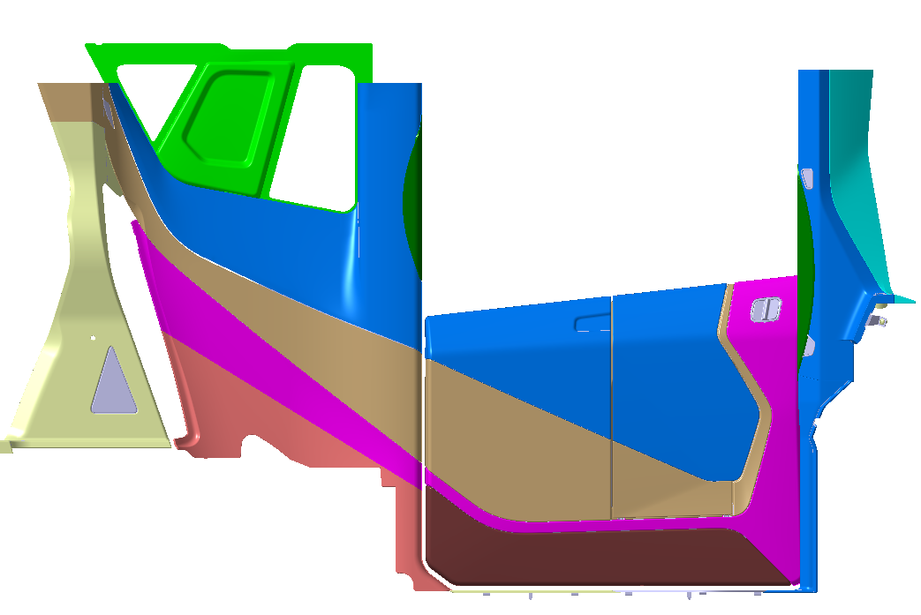
表面处理及工艺建议——侧围立柱
Surface treatment and process suggestions - Piller treams
MIRROR GLASS BLACK PAINT
WRAP
HARD PLASTIC
HARD PLASTIC
WRAP
COLOR A
COLOR B
ONE PIECE
2 COLOR
HARD PLASTIC
HARD PLASTIC
CARPET

Slide 10
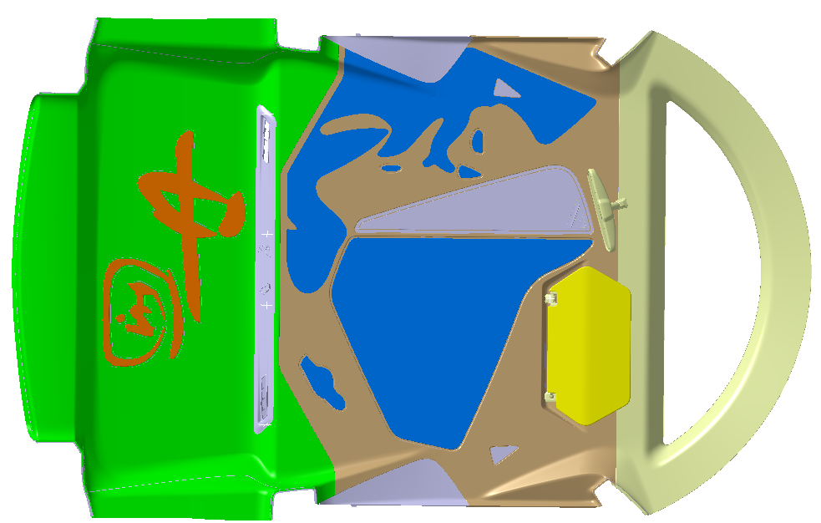
表面处理及工艺建议——顶棚
Surface treatment and process suggestions - ROOF
NEW DESIGN
WRAP
ALL WRAP WITH GRAPHICS IN MATERIAL

Slide 11

谢谢
THANK YOU
品质成就价值 专注铸就未来

